Slide 1


Book recommendation system (bookmind.)
Yuvanraj r (43111087)
Sugaman (43110925)

Slide 2
agenda
Problem statement
Feasibility analysis
Software requirement specification
Purpose
Scope
Overview
System architecture
Er diagram
Screenshots
Ui/ux planning (modules)
Features
Conclusion

Slide 3
Problem statement
Students and readers often struggle to choose suitable books based on their available time, reading mood, preferred genre, and language. With thousands of books available, it becomes difficult to manually search for the right one. Therefore, a system is needed that intelligently suggests books based on the user’s preferences using a rule-based recommendation engine.
This system should accept inputs such as genre, mood, reading time, and language, and recommend the most relevant books along with brief descriptions, ratings, and reading duration.

Slide 4
Feasibility analysis
✔ Technical Feasibility
All required tools (Java, Spring Boot, React, MySQL) are free, widely used, and easy to install. No advanced hardware or external APIs required. A rule-based algorithm is very easy to implement.
✔ Operational Feasibility
The system is simple to operate. Minimal UI → users can easily input preferences and get results. Admins can upload CSV data without technical knowledge.
✔ Economic Feasibility
Zero cost:
Uses open-source tools
No external APIs
No hosting required (can run locally)
This makes the system fully cost-effective for college projects

Slide 5
Software requirement specification
1) Functional Requirements
User Functions
Input Preferences:
User selects genre, mood, language, and reading time.
View Recommendations:
System returns top-ranked books with necessary details.
View Book Details:
Title
Author
Description
Tags
Estimated reading time
Rating
Image (optional)

Slide 6
.
2) Non-functional Requirements
Performance:
Recommendations must be generated within 2 seconds.
System must handle up to 500 book records easily.
Usability:
Clean, minimal UI to ensure ease of use.
Accessible on desktop and mobile browsers.
Reliability:
Must handle incorrect inputs gracefully.
Ensure database integrity.
Maintainability:
Modular code structure
Layered architecture (Controller → Service → Repository → DB)
Security:
Basic security for admin operations (optional).
Input validation to prevent errors.

Slide 7
.
3) Software & Hardware Requirements
Software Requirements
Backend:
JDK 17+
Spring Boot 3
Maven
Frontend:
React (optional) or HTML/CSS/JS
Database:
MySQL 8 / H2 Database
Tools:
VS Code / IntelliJ IDEA / Eclipse
Postman for API testing
Git (optional)
Hardware Requirements
Minimum 4 GB RAM
2 GHz processor
500 MB free disk space

Slide 8
purpose
The purpose of this project is to develop a simple, user-friendly, and intelligent Book Recommendation System that helps users quickly find the most suitable books without manually searching through large collections.
The system aims to:
Provide personalized book suggestions
Save time for readers
Enhance the reading experience
Offer recommendations based on user preferences

Slide 9

scope
In-Scope
Allows users to input:
Genre
Reading time
Mood
Language
Displays book details:
Title
Author
Blurb
Estimated reading time
Rating
Book cover image (if added)

Slide 10
overview
The Book Recommendation System is a Java full-stack application built using:
Backend: Spring Boot
Database: MySQL / H2
Frontend: React or HTML/CSS/JS
Data Input: CSV book dataset
Logic: Rule-based scoring algorithm
System Workflow
User enters preferences (genre, time, mood, language).
Backend fetches all books from the database.
Each book is scored based on:
Genre match
Time fit
Mood tag match
Rating
Language
Top recommendations are returned to the frontend.
Frontend displays them as clean cards with description & cover image.

Slide 11
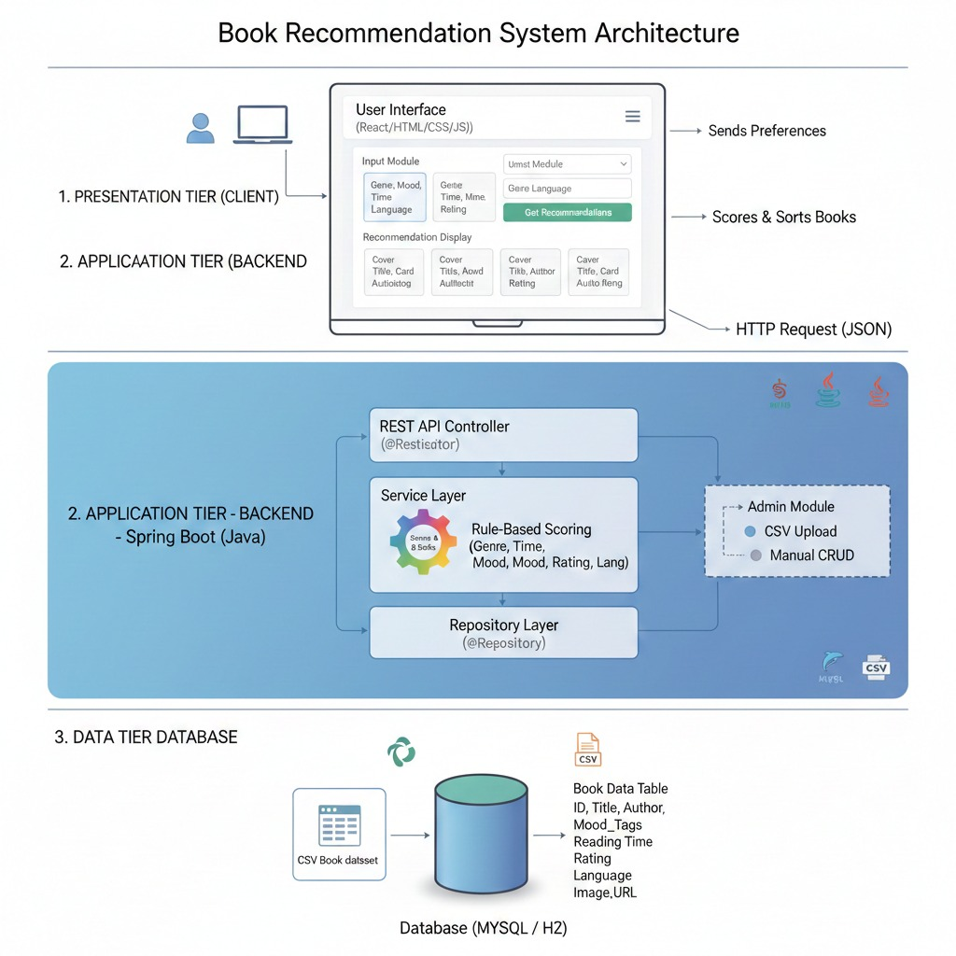
System architecture

Slide 12
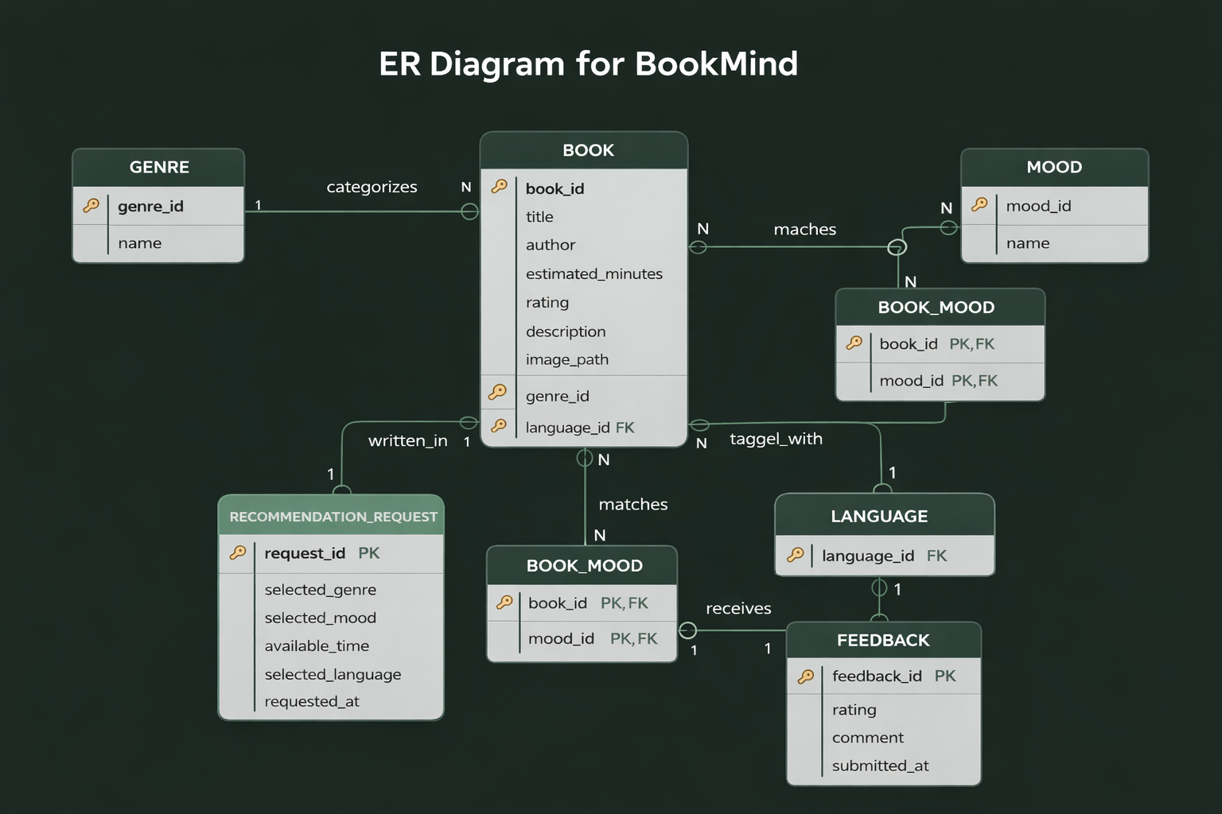
Er diagram

Slide 13
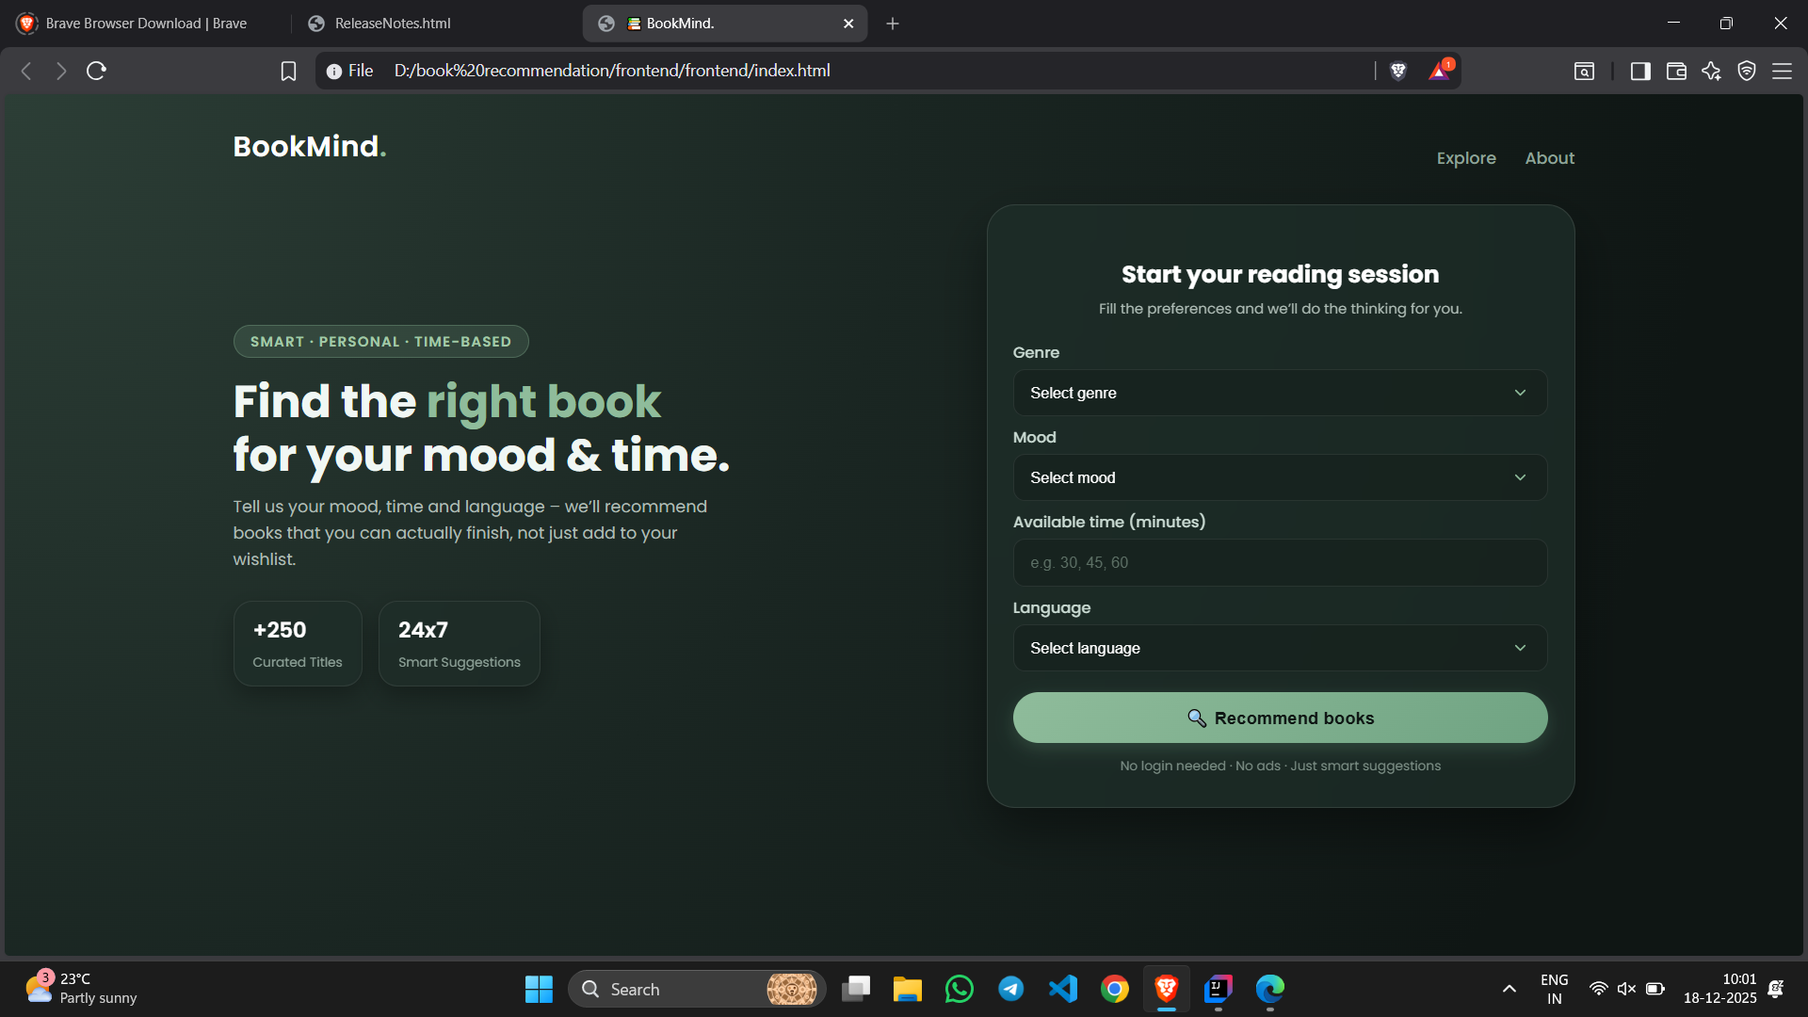
screenshots

Slide 14
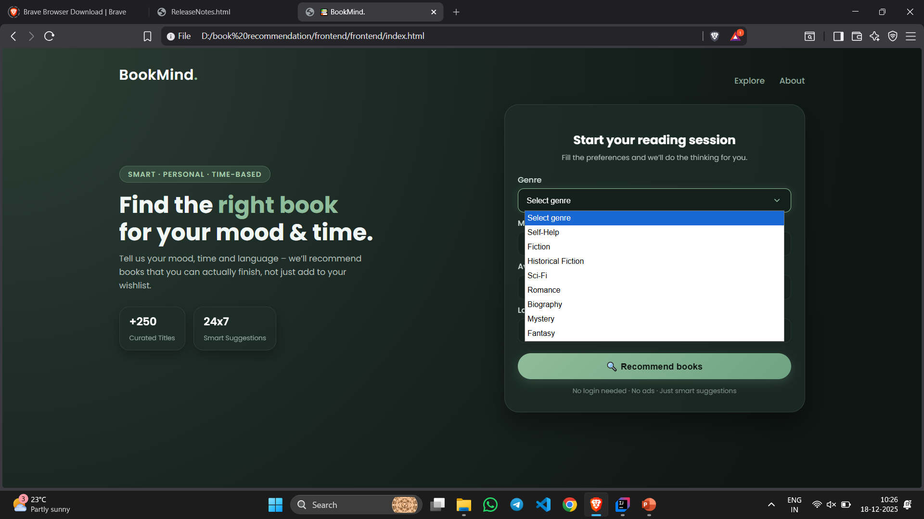
screenshots

Slide 15

screenshots

Slide 16
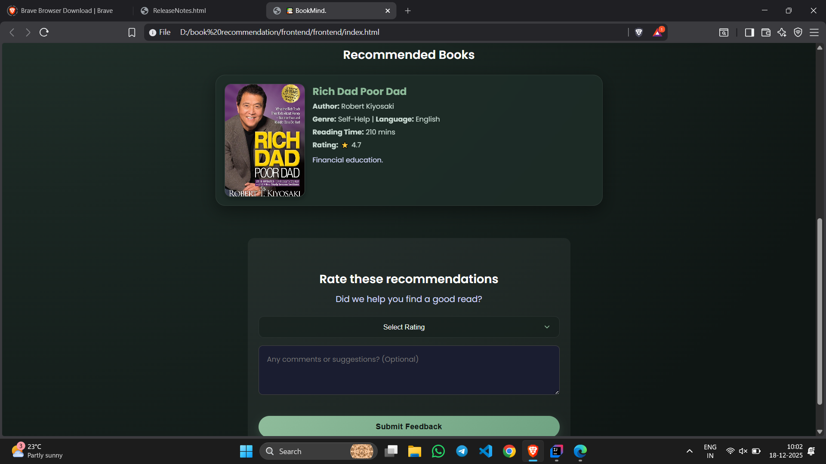
screenshots

Slide 17
Ui/ux planning
1)Home / Input Module
User selects Genre
User selects Mood
User enters Available Reading Time
User chooses Language
“Get Recommendations” button
2)Recommendation Display Module
Each book displayed in card format:
Cover image
Title
Author
Short description
Reading time
Rating
“Why this book?” reason (algorithm-based)

Slide 18
.
3) Book Details Module (Optional)
Expanded view of selected book
Full description and tags
Link (optional)
Simple and clean modal or separate section
4) Admin Module (Optional)
Upload CSV to import books
Add/edit/delete book entries
Minimal dashboard with simple forms

Slide 19
.
5) Error & Validation Module
Error messages for missing inputs
Proper validation for time input
“No books found” fallback message
6) Responsive Layout Module
Adaptive design for:
Mobile
Tablet
Desktop
Auto-adjusted card layout

Slide 20
features
Personalized Suggestions based on genre, mood, reading time, and language
Rule-Based Recommendation Engine for accurate, relevant book results
Minimal and User-Friendly Interface for quick preference input
Detailed Book Information including title, author, blurb, rating, and reading time
Supports Book Cover Images for a better visual experience
CSV-Based Book Import to easily load multiple books into the system
Fast Response Time with recommendations generated in seconds
Easily Scalable — new books, genres, or moods can be added anytime

Slide 21
conclusion
The Book Recommendation System successfully provides personalized book suggestions based on user preferences such as genre, mood, language, and available reading time. By using a rule-based recommendation approach, the system delivers accurate and relevant results without relying on complex machine-learning models or external APIs.
The project demonstrates effective use of Java full-stack technologies, including Spring Boot for backend development, database integration for data management, and a clean, minimal user interface. It is scalable, easy to maintain, and can be enhanced in the future with features such as user accounts, advanced recommendations, and real-time book data integration.
Overall, this system offers a simple yet efficient solution to help users discover suitable books quickly and enhances their reading experience.

